Slide 1
Data Visualization

Slide 2
Agenda
Visualization using Seaborn
Visualization using Plotly

Slide 3
Data visualization
Representation of the data in a pictorial or graphical format
First step of data analysis
Allow us to get the intuitive understanding of the data
Helps to visualize the patterns in the data

Slide 4
Visualization using Seaborn

Slide 5
Introduction
Seaborn is used for data visualization
It is based on the matplotlib
It provides a high-level interface for drawing attractive and informative statistical graphics

Slide 6
Functionalities of seaborn
Allows comparison between multiple variables
Supports multi-plot grids
Univariate and bivariate visualization
Availability of different color palettes
Estimates and plots linear regression line

Slide 7
Installation
Open terminal program (for Mac user) or command line (for Windows) and install it using following command:
conda install seaborn
Or
pip install seaborn

Slide 8
Installation
Alternatively, you can install seaborn in a jupyter notebook using below code:
!pip install seaborn
To import the library, use the command:
Import seaborn as sns

Slide 9
Strip plot
It is similar to the scatter plot with one categorical variable
It is used to understand the underlying distribution of the data
One axis represents the categorical variable and another represents the value corresponding to the categories

Slide 10
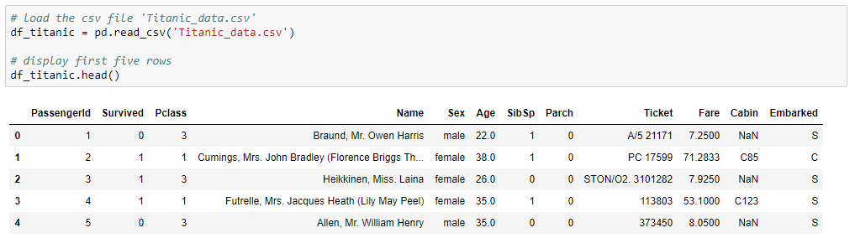
Read the data
Load the titanic data to create a strip plot

Slide 11
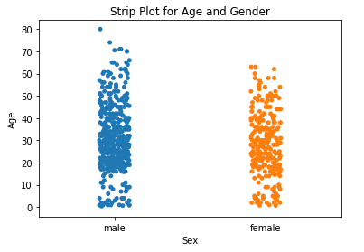
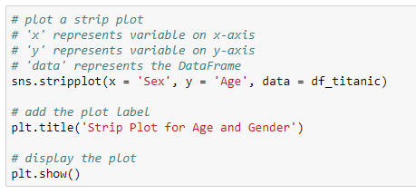
Strip plot
Check the distribution of age based on gender
The plot shows that, the maximum age of males is higher than of females

Slide 12
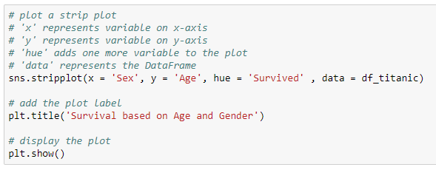
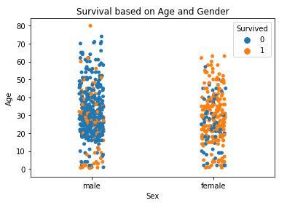
Strip plot
Add the one more categorical variable to strip plot using the parameter, ‘hue’
Add a categorical variable
Proportion of female survivors is higher than males

Slide 13
Violin plot
It is similar to a boxplot, that displays the kernel density estimator of the underlying distribution
It shows the distribution of the quantitative data across categorical variables such that those distributions can be compared

Slide 14
Read the data
Load the titanic data to create a violin plot

Slide 15
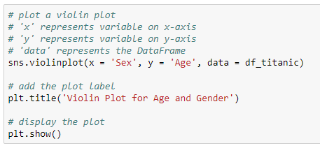
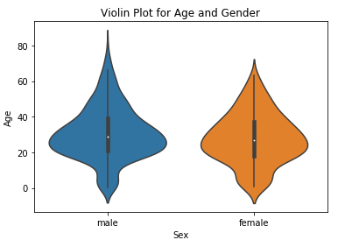
Violin plot
Plot the violin plot to compare the distribution of age based on gender
The box plot is plotted inside the violin plot

Slide 16
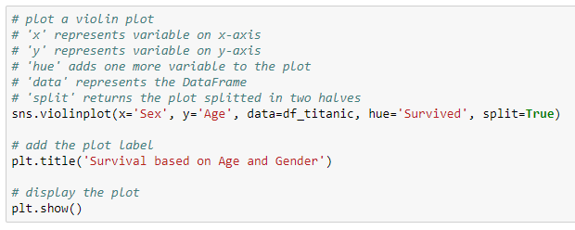
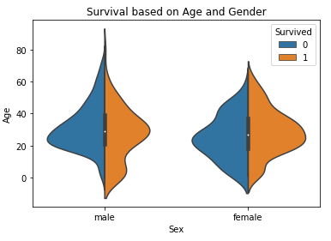
Violin plot
Violin plot can be divided into two halves, where one half represents surviving while other half represents the non-surviving passenger
Pass ‘True’ as value for the split parameter

Slide 17
Swarm plot
It is the combination of strip and violin plots
The points are adjusted in such a way that they don't overlap, which gives the better representation of the data

Slide 18
Read the data
Load the titanic data to create a swarm plot

Slide 19
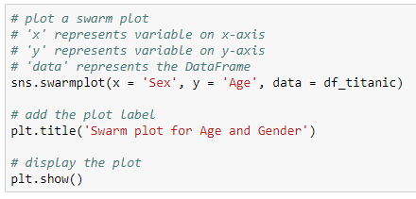
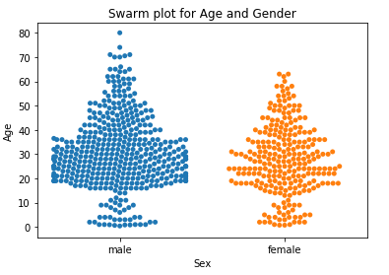
Swarm plot
Create a swarm plot for the distribution of age based on gender
High proportion of males are in the age range 20 - 40

Slide 20
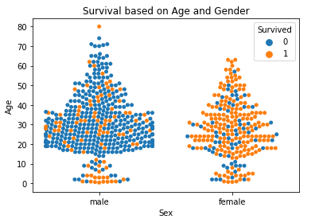
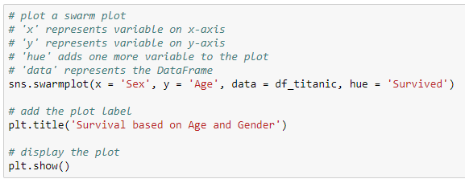
Swarm plot
Add one more categorical variable ‘Survived’ to the swarm plot using the parameter, ‘hue’

Slide 21
Pair plot
It displays the pairwise relationship between the numeric variables
The pairplot() method creates a matrix; where the diagonal plots represent the univariate distribution of each variable and the off-diagonal plots represent the scatter plot of the pair of variables

Slide 22
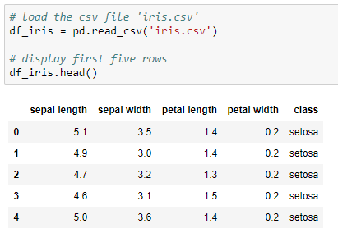
Read the data
Use the iris data to create the pair plot

Slide 23
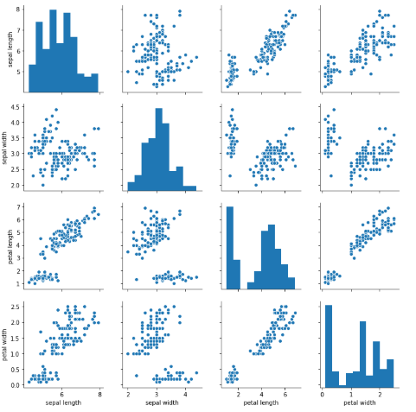
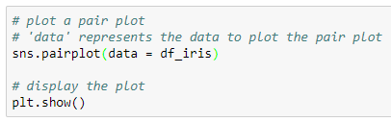
Pair plot

Slide 24
Distribution plot
It displays the distribution of the data
It is a variation of histogram that uses kernel smoothing to plot values, allowing for smoother distributions by smoothing out the noise

Slide 25
Read the data
Load the titanic data to create a distribution plot

Slide 26
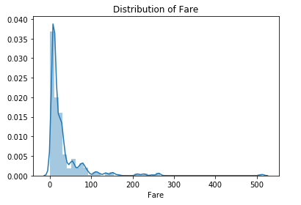
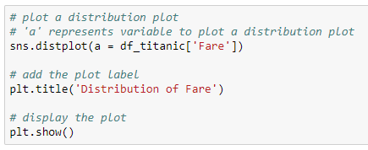
Distribution plot
The distplot() method plots the histogram with a Kernel Density Estimator (KDE), which is a used to estimate the probability distribution function of a random variable
KDE
The plot shows the positive skewness of the ‘Fare’

Slide 27
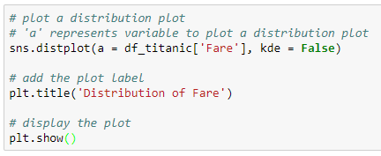
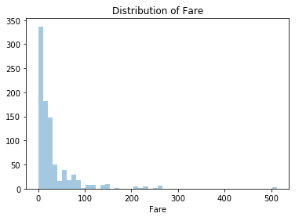
Distribution plot
Plot the distribution of ‘Fare’ without the kernel density estimator (KDE)
Returns the plot without kde

Slide 28
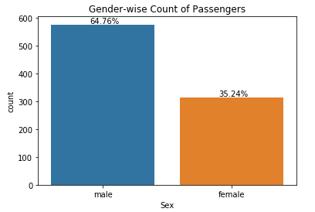
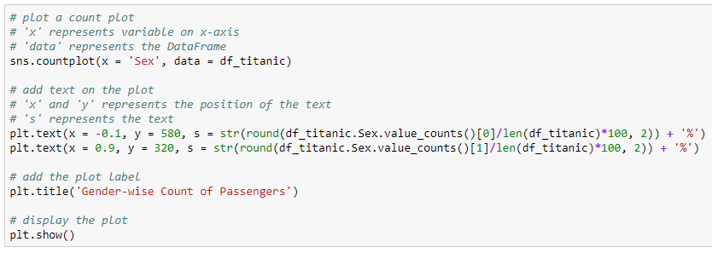
Count plot
It is similar to the bar plot. However, it shows the count of the categories in a specific variable
Calculate the gender-wise percentage upto 2 decimals

Slide 29
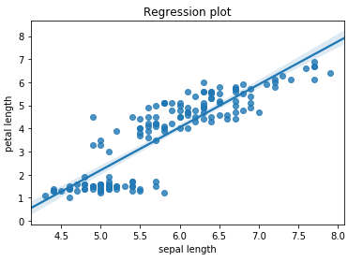
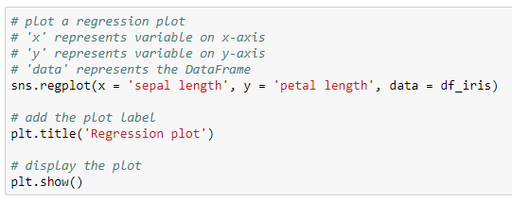
Regression plot
It is used to study the relationship between the two variables with the regression line

Slide 30
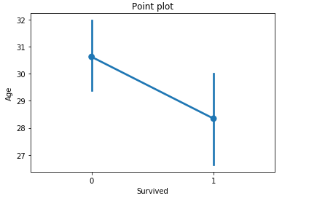
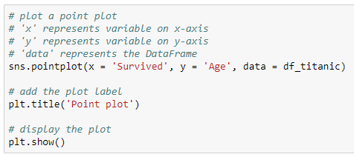
Point plot
It represents an estimate of central tendency (by default, mean) by position of scatter points and provides the indication of the uncertainty around that estimate using error bars
Error bar

Slide 31
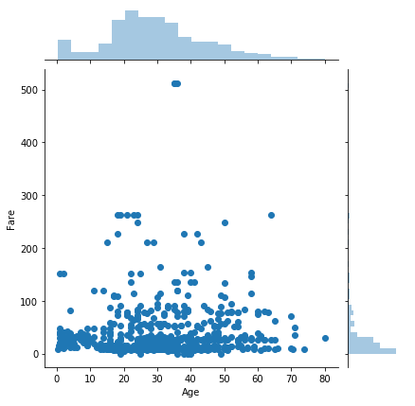
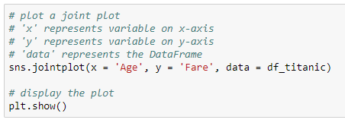
Joint plot
A joint plot is a bivariate plot along with the distribution plot along the margins

Slide 32
Heatmap
A heatmap is a two-dimensional graphical representation of data where the individual values that are contained in a matrix are represented by the different colors
Heatmap for correlation shows the correlation between the variables on each axis

Slide 33
Read the data
Use the iris data to create the heatmap

Slide 34
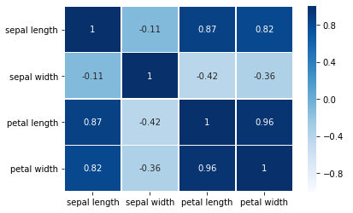
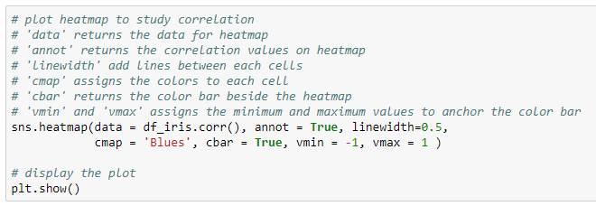
Heatmap
Add values to the heatmap
Assigns color to each cell
The variables ‘petal width’ and ‘petal length’ are highly positively correlated

Slide 35
Heatmap
Diagonal cells represent the correlation of the variable with itself; thus, the value will always equal to 1
The off-diagonal entries represent the correlation between the pair of variables
The color bar beside the heatmap shows that the dark blue color represents the positive correlation (near to +1) and light blue color represent the negative correlation (near to -1)

Slide 36
Visualization using Plotly

Slide 37
Plotly
Plotly allows us to make beautiful, interactive, explorable charts
It is an open-source and browser-based graphing library
We can get the values on the graph by hovering over the graph

Slide 38
Plotly
Import the offline version of plotly as:
Import the subpackage ‘express’ as:

Slide 39
Read the data
Load the titanic data for further manipulations:

Slide 40
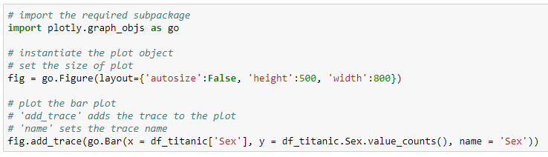
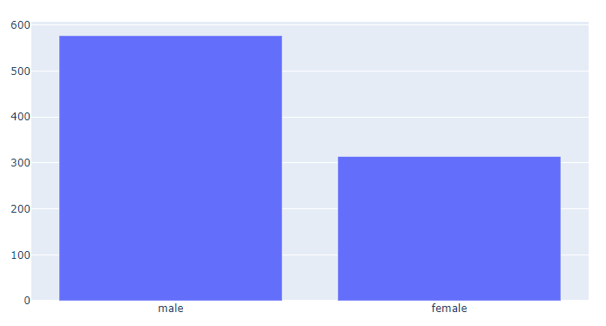
Bar plot
Plot a bar plot to get the gender-wise count of passengers
Male population is more in the data than female population

Slide 41
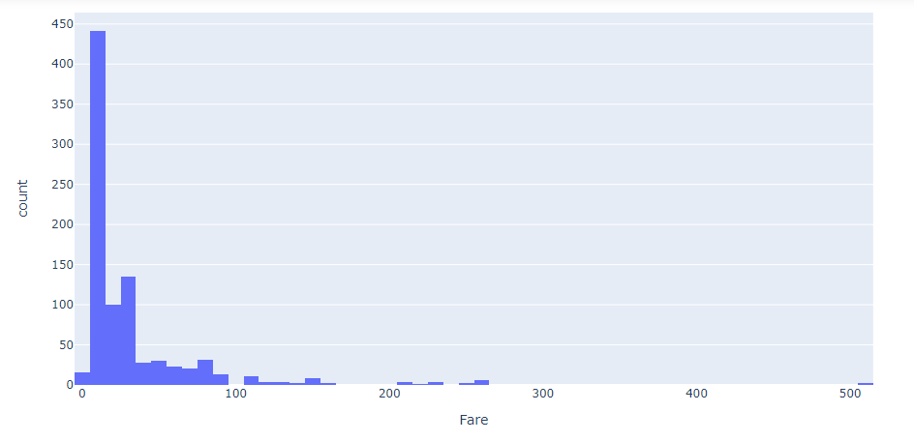
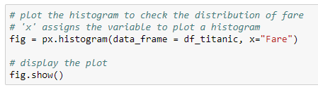
Histogram
Plot a distribution of fare of the passengers
The histogram shows the positive skewness in the ‘Fare’. There are few extreme points near to Fare = 500

Slide 42
Read the data
Use the iris data for further manipulations:

Slide 43
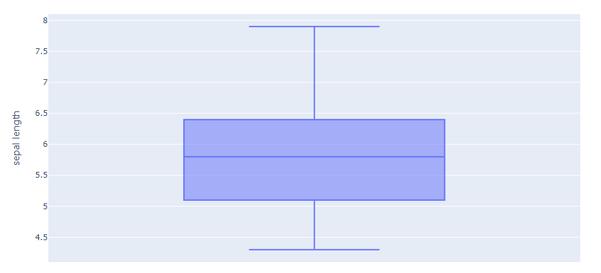
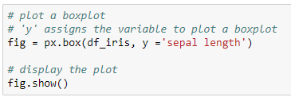
Boxplot
The boxplot shows that, the ‘sepal length’ is not significantly skewed

Slide 44
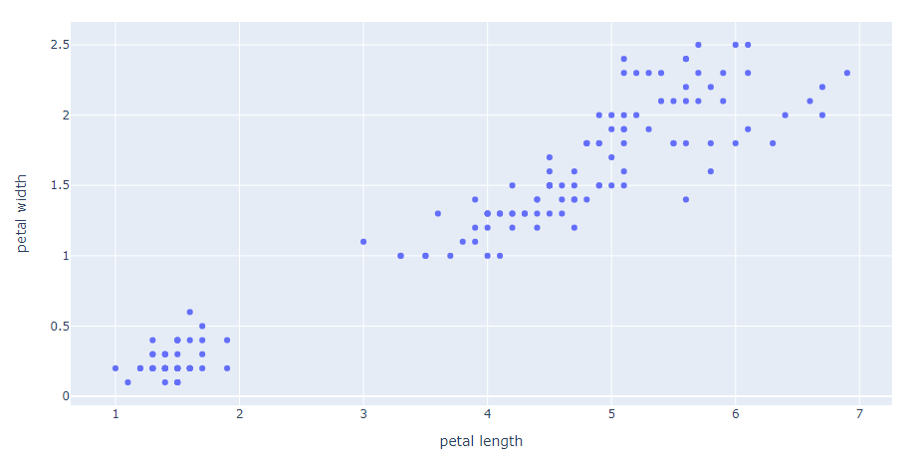
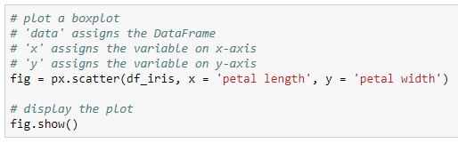
Scatter plot
The plot shows that, the variables ‘petal length’ and ‘petal width’ are positively correlated

Slide 45
Thank You

